Slide 1


Application of Web Services
Web services have become an integral part of modern software development, enabling seamless integration, data exchange, and cross-platform compatibility. This presentation explores the various applications and benefits of implementing web services in diverse business scenarios.
by Ujjwal Singh

Slide 2
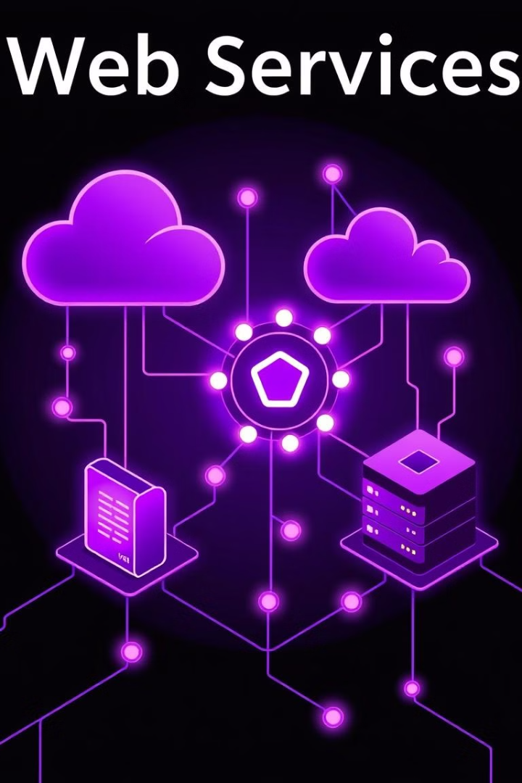
What are Web Services?
1
Standardized Communication
2
Service-Oriented Architecture
Web services use standardized protocols like SOAP, REST, and JSON to enable interoperable machine-to-machine interaction over a network.
Web services are the building blocks of a service-oriented architecture, where applications are composed of loosely coupled, reusable services.
3
Platform Independence
Web services allow different software systems, running on various platforms, to communicate and exchange data seamlessly.

Slide 3
Common Web Service Architectures
SOAP (Simple Object Access Protocol)
REST (Representational State Transfer)
SOAP is a protocol that uses XML to define the message format and message processing rules. It is often used in enterprise-level applications that require more robust security and reliability.
REST is an architectural style that uses HTTP methods to perform operations on resources. It is lightweight, scalable, and well-suited for web-based applications and mobile devices.

Slide 4
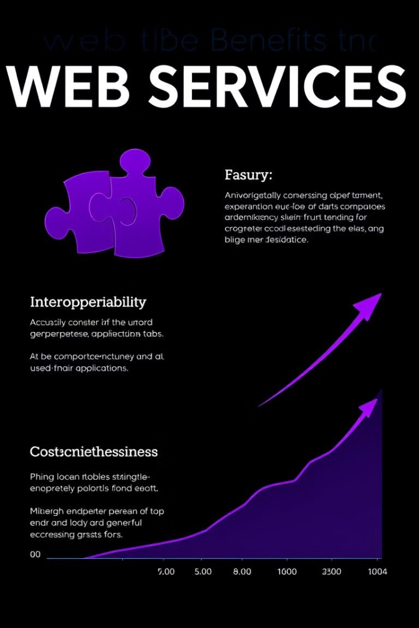
Benefits of Implementing Web Services
Interoperability
Reusability
Web services enable seamless communication between different software systems, regardless of their underlying platforms or programming languages.
Web services can be easily integrated into multiple applications, reducing development time and costs.
Scalability
Cost-Effectiveness
Web services can be easily scaled to handle increasing workloads and user demands.
Implementing web services can lead to significant cost savings by reducing the need for custom integrations and maintenance.

Slide 5





Use Cases for Web Services
E-commerce
Finance
Web services enable seamless integration between e-commerce platforms, payment gateways, and inventory management systems.
Web services are used in the financial industry for online banking, stock trading, and financial data aggregation.
Enterprise Applications
Mobile Integration
Web services facilitate data exchange and integration between disparate enterprise systems, such as ERP, CRM, and HR.
Web services enable mobile apps to access and leverage data and functionality from backend systems.

Slide 6

Web Services Security Considerations
1
Authentication and Authorization
2
Data Encryption
Implementing SSL/TLS encryption protects sensitive data transmitted between web service clients and servers.
Ensuring only authorized users and applications can access web services is crucial to prevent unauthorized access.
3
Monitoring and Logging
Continuous monitoring and logging of web service activities helps detect and respond to potential security threats.

Slide 7

Challenges and Limitations of Web Services
1
Performance
Ensuring high performance and low latency for web services can be challenging, especially for applications with real-time requirements.
2
Complexity
The inherent complexity of web service standards and protocols can make implementation and maintenance more difficult.
3
Versioning
Managing the evolution of web services and ensuring backward compatibility can be a significant challenge.

Slide 8




Best Practices for Web Service Development
Architectural Design
Carefully plan the overall architecture and design of your web services to ensure scalability, maintainability, and reusability.
Robust Testing
Implement comprehensive testing strategies, including unit tests, integration tests, and end-to-end tests, to ensure the reliability of your web services.
Thorough Documentation
Provide clear and detailed documentation for your web services, covering API specifications, usage examples, and troubleshooting guides.

Slide 9

Conclusion
Web services have become a vital component of modern software development, enabling seamless integration, data exchange, and cross-platform compatibility. By understanding the key concepts, architectures, and best practices, organizations can unlock the full potential of web services and drive innovation in their digital transformation journey.

